Slide 1
Literature Review on
Side Channel attack on Hardware Wallet

Slide 2
Main purpose of a hardware wallet is
Generate a BIP32 seed, which will be used to derive public/private keys, which are used for signing the transaction.
Store public and private keys in a safe memory space for receiving or sending cryptocurrencies.
Perform cryptocurrency transactions for sending and receiving funds.

Slide 3
Mainly I have read these paper which is closely related to our topic
Side-Channel assessment of Open Source Hardware Wallets
EMFI Attacks against USB Stacks
Stealing Keys From Hardware Wallets: A Single Trace Side-Channel Attack on Elliptic Curve Scalar Multiplication Without Profiling

Slide 4
Analysis of “Side-Channel Assessment of Open Source Hardware Wallets. “
The paper describes two profiled side-channel attack
1) In the first attack, they extract the user’s wallet PIN.
2) In the second attack, they extract the private signing key from the ECDSA scalar multiplication using a single signature.

Slide 5
Analysis of “Side-Channel Assessment of Open Source Hardware Wallets. “
For this attack, the Targeted device is Trezor One hardware wallet which is an open-source hardware wallet.
The MCU used in this device is a STM32F205RE

Slide 6
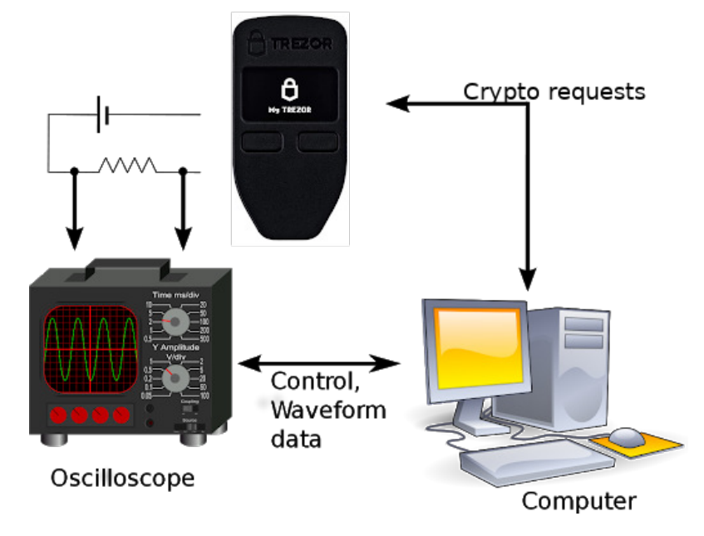
Analysis of “Side-Channel Assessment of Open Source Hardware Wallets. “
- Computer requests specific operations to Trezor Ones, while a digital oscilloscope measures its power consumption, and after applying suitable analysis on the power consumption we can find the PIN or scalar multiplication of a given crypto wallet.
Schematic representation of attack setup

Slide 7
Analysis of “Side-Channel Assessment of Open Source Hardware Wallets. “
In the trezor device, they didn’t use the original firmware of Wallet instead they modify the firmware design, which allows easy characterization for the profiling phase of the attacks such as :
Various Trezor security mechanisms were disabled: such as the Pin Try Counter, the increasing timer between wrong PIN requests, the pinMatrix randomization, etc.
Note : This modified firmware was used only on the device used for the characterization of our attacks. The firmware used to actually pass our attack was not modified.

Slide 8
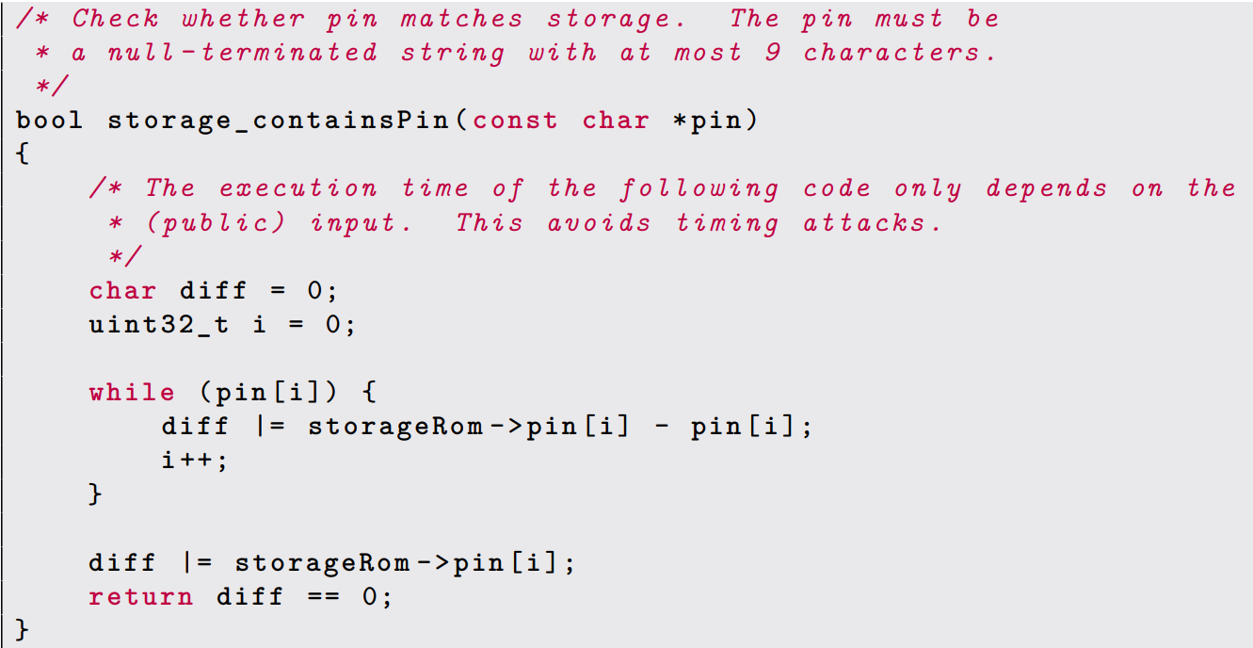
Analysis of “Side-Channel Assessment of Open Source Hardware Wallets. “
storageRom -> pin [i] stored actual PIN of wallet
pin [i] is the input of wallet entered by the user.
Noticed that storageRom->pin digits are processed one after the other, and the comparison with pin is done in a deterministic way
Source code for PIN verification function

Slide 9
Analysis of “Side-Channel Assessment of Open Source Hardware Wallets. “
Observing the power consumption of the storageRom->pin function allows implementing a Divide & Conquer strategy for retrieving the PIN.
They attack each PIN digit individually, so if the PIN size is N digits long, then we have to mount an N side-channel attack.
From a side-channel perspective, there are several sensitive values in this function that depend on the secret storageRom->pin: the value at each step (digit) of the while loop of:
fi can output only 18 differents values: 0, 1, 2, 3, 4, 5, 6, 7, 8, 248, 249, 250, 251, 252, 253, 254, 255

Slide 10
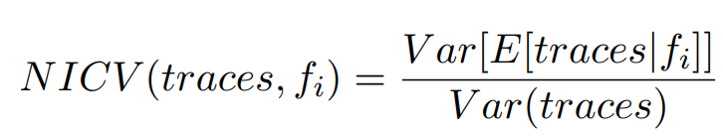
Analysis of “Side-Channel Assessment of Open Source Hardware Wallets. “
We chose the Normalized Inter-Class Variance (NICV) in order to do so
A NICV close to 0 means that our partitioning (i.e. sensitive value fi) failed to explain the variance. A NICV of 1 means that our partitioning perfectly explained the variance.
In our case NICV is close to 1 so our sensitive value and our power traces are closed to each other.

Slide 11
Analysis of “Side-Channel Assessment of Open Source Hardware Wallets. “
Paper defined profiled side-channel attacks in two phases:
1) The learning phase: where we use an open device A to learn how it behaves
2) The matching phase: where we use what we have learned on a new device B whose secret PIN is unknown
1) Learning phase: Based on a training set of data containing observations whose categories are known, a classification problem consists in identifying to which category a new observation belongs.
- An observation is a power traces from a PIN login attempt on the open device A
- The training set of data are the power traces from the profiling set
- The categories are the values returned by fi at each trace(18 values for each fi)

Slide 12
Analysis of “Side-Channel Assessment of Open Source Hardware Wallets. “
the new observation is a power trace from a PIN attempt on the device B for which we don’t know the secret PIN.
For each digit i (0 ≤ i < 4), we build Classifier(i) , by feeding it with the power traces from the profiling set L, labeled with the value of fi(storageRom->pin_j, pin_j ).
At the end of this learning phase, we get a statistical classifier: a decision function that is designed to predict the value of storageRom->pin[i].
There are several statistical classifiers like LDA(Linear Discriminant Analysis), QDA (Quadratic Discriminant Analysis), SVM(Support Vector Machine) etc. which we can use to define Classifier.

Slide 13
Analysis of “Side-Channel Assessment of Open Source Hardware Wallets. “
Now that the learning phase is done, we have 4 classifier functions, each of them in charge of retrieving a PIN digit from a power trace.
2) Matching Phase :
retrieving the first PIN digit on a device B
The matching phase consists in applying the previously built statistical classifiers on new power traces, acquired from a new Trezor One device B, with unknown storageRom->pin, and random known values for the presented pin
The attack scenario involves acquiring 15 power traces from the new device, with a fixed 4-digit storageRom->pin and a random 4-digit presented pin. The maximum number of PIN tries on a Trezor device is 15, so the attack needs to succeed within this limit.

Slide 14
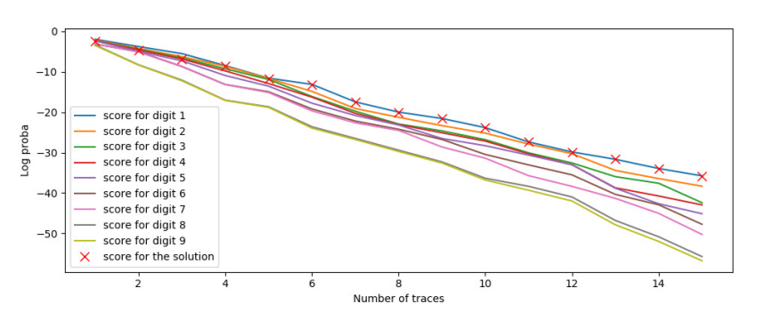
Analysis of “Side-Channel Assessment of Open Source Hardware Wallets. “
The example focuses on attacking storageRom->pin[0], one digit of the PIN. The acquired traces are individually passed through Classifier0, which returns a log-probability score for each possible value of storageRom->pin[0]. The digit with the highest score is considered the most likely value for storageRom->pin[0].
- Figure illustrates the progression of the 9 scores for each possible value of the digit 0. From the 6th trace onwards, the value with the best score matches the actual solution (digit0 == 1, indicated with a red "×"). This indicates that Classifier0 required only 6 power traces to accurately determine the correct value for digit0.

Slide 15
Analysis of “Side-Channel Assessment of Open Source Hardware Wallets. “
Now we discuss Breaking Scalar Multiplication
- The scalar multiplication is used on elliptic curve operations. Let C be an elliptic curve, P ∈ C a point on this curve, and k ∈ N a positive integer. The scalar multiplication computes the point G = [k]P, which also lies on the curve.
Importance of Scaler multiplication :
- During an elliptic curve public key derivation: the scalar used is the value of the private key
- During an ECDSA signature: the scalar used is a nonce whose value can lead to the disclosure of the private key from the signature
- Here scalar is 256 bit long.

Slide 16
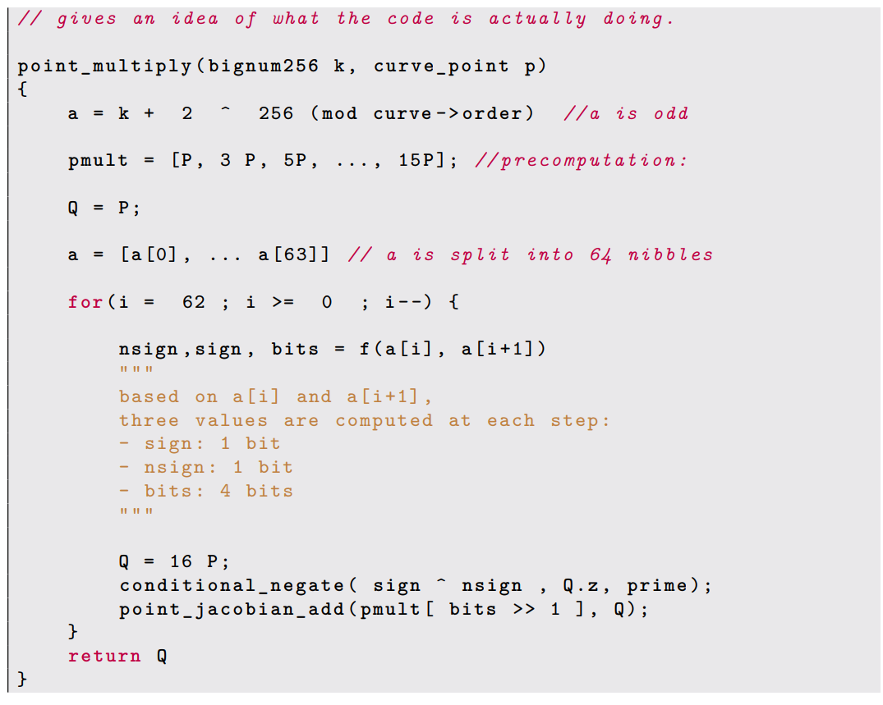
Analysis of “Side-Channel Assessment of Open Source Hardware Wallets. “
During a scalar multiplication [k]P:
- k is transformed into a:
a = k + 2^256 mod order
- [3]P, [5P], . . . , [15]P are precomputed and stored into pmult,
- The main loop is executed, on each nibble of a
In this main loop we see that:
- sign, nsign, and bits are derived from a,
- conditional_negate is called with sign ^ nsign
- one of the precomputed pmult points is manipulated depending on bits >> 1
So from, knowing the 64 values of (sign, nsign,bits>>1) allows reconstructing a and from a we find scalar k.
Pseudo code for a targeted function to retrieve scalar

Slide 17


Analysis of “Side-Channel Assessment of Open Source Hardware Wallets. “
We define the sensitive values as :
- We follow Divide & Conquer strategy, these are the 2 × 64 values that we will retrieve through independent side-channel attacks, in order to reconstruct the scalar k.
The same setup as the PIN attack is used for power acquisition. We acquire side-channel power traces during several executions of the point_multiply function

Slide 18
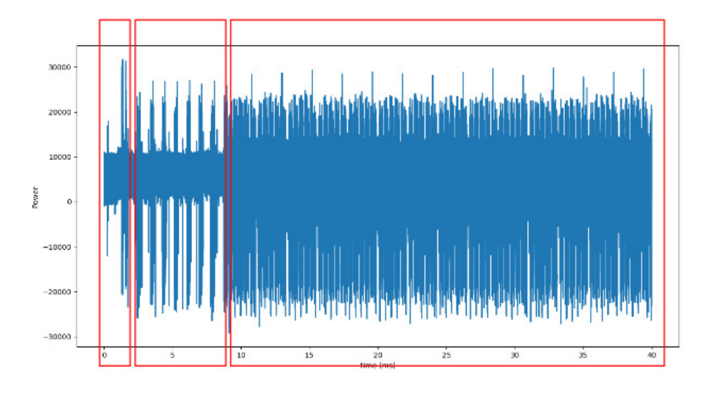
Analysis of “Side-Channel Assessment of Open Source Hardware Wallets. “
Figure shows a single power trace acquired from the beginning of the point_multiply function. The red rectangles frame the successive steps of the algorithm described in previous slide.
The construction of a from k at the first red rectangle
The 7 steps of the pmult computation at the second red rectangle
The 14 first steps out of the 64 in the main loop at the last red rectangle

Slide 19
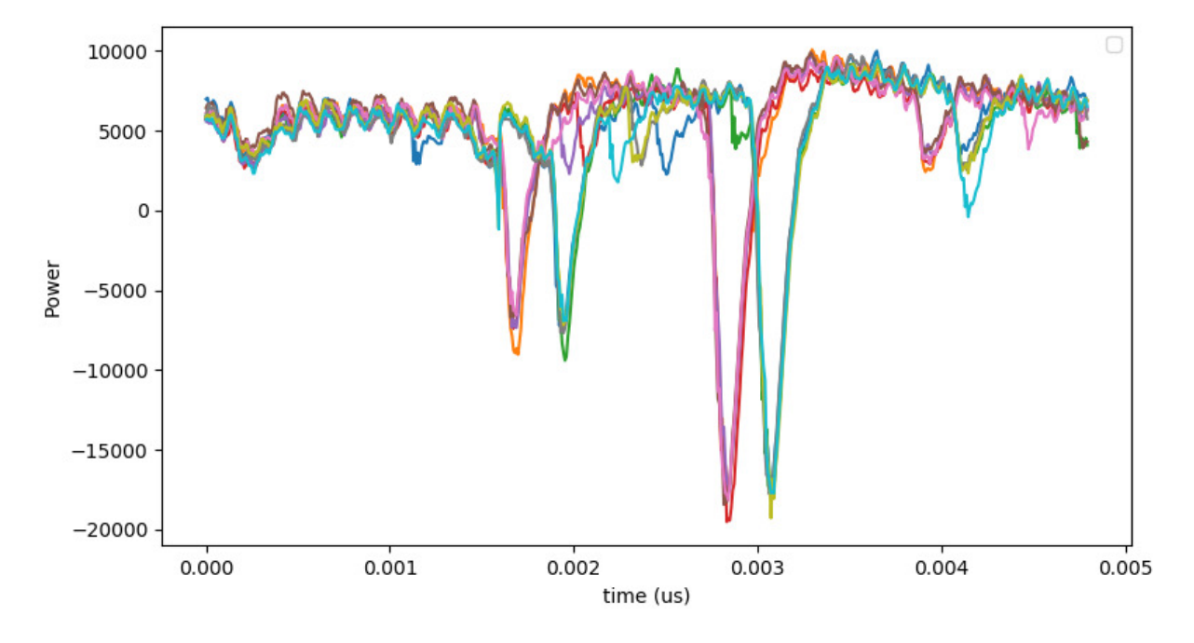
Analysis of “Side-Channel Assessment of Open Source Hardware Wallets. “
We build our profiling set by acquiring 150000 power traces captured during the point_multiply execution.
We compute NICV on the profiling set with our sensitive values fi and gi, and we observe a strong dependency between our power leakage and our sensitive values.
Now we try to retrie signi ⊕ nsigni with a timing attack
Figure shows 10 power traces zoomed in on a portion of a single step of the loop
The traces can clearly be split into two classes
The first class occurs when fi(k) = 0, and the second class occurs when fi(k) = 1

Slide 20
Analysis of “Side-Channel Assessment of Open Source Hardware Wallets. “
Now we try to retrie (bitsi >> 1) with a profiled attack
Now we have to retrieve the 64 successive values of (bitsi >> 1). In order to do so, we will mount a profiled side-channel attack.
The learning phase consists in using the profiling set with the sensitive values gi . The end result is a set of Classifier(i) such that:
Now on a new device, running the point_multiply function with unknown scalar k, we acquired a few power traces and input them to the Classifier(i) .

Slide 21
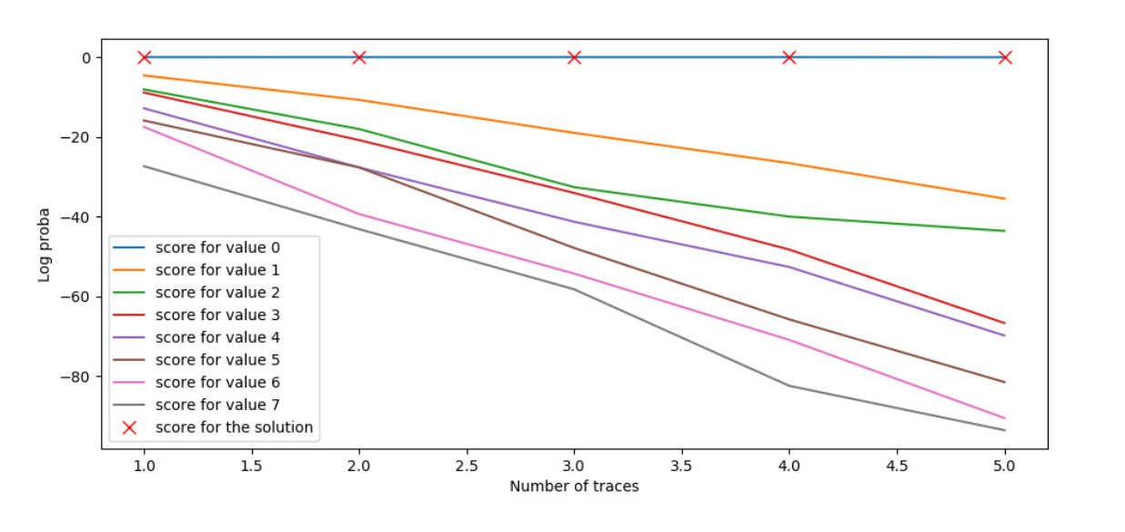
Analysis of “Side-Channel Assessment of Open Source Hardware Wallets. “
Figure shows the progression of the 8 possible values that (bitsi >> 1) could take. This attack works with only a single trace
From all those recovered intermediate values, the scalar k can be reconstructed.

Slide 22
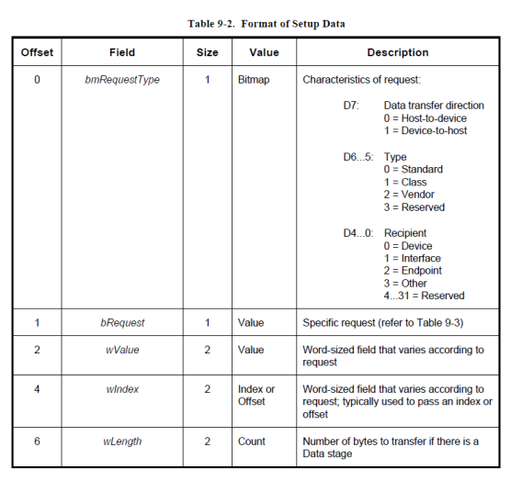
Analysis of “EMFI Attacks against USB Stacks “
Our wallet is connected through USB port available in PC.
“Device descriptors” describe all aspects of the connected USB device(Hardware Wallet).
These descriptors are one of the first items requested by the host computer, as it helps the host understand how to talk to the new USB device, and what the device is.
As part of the setup request, the fields shown in Figure will be transferred from the host to the device.

Slide 23
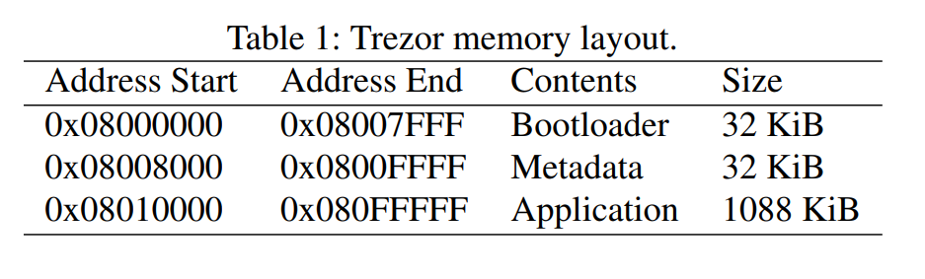
Analysis of “EMFI Attacks against USB Stacks “
The wLength field is set by the host computer and indicates the maximum amount of data the device can return.
The actual sensitive recovery seed is stored in
flash memory in a ‘metadata’ section.
The bootloader can be entered by holding down the two buttons on the front of the Trezor, and allows a firmware update to be loaded over USB.
There are mainly two types of memory present, 1) SRAM 2)Flash Memory When firmware updating happens, that time all sensitive information of the device is temporally stored in SRAM, so if one can recover what is stored in SRAM while updation they can get the recovery seed string and clone the wallet

Slide 24
Analysis of “EMFI Attacks against USB Stacks “
Various attacks have been presented on this device to recover sensitive information from SRAM. (https://saleemrashid.com/2017/08/17/extracting-trezor-secrets-sram/)and (Wallet.fail)
Both of these attacks targeted SRAM, as the read protection on SRAM is less thorough than the read protection implemented on the FLASH memory.
In this paper author try to read data directly from FLASH memory.

Slide 25
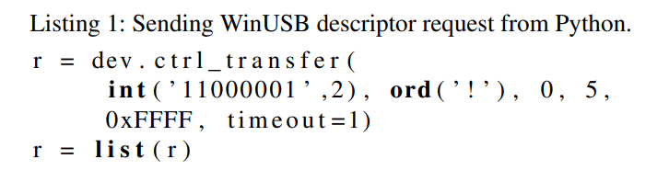
Analysis of “EMFI Attacks against USB Stacks “
As an attacker author try to send this request from host to wallet.
Various parameter is passed which is listed in the previous table.
But the main thing which we focus on is the length which we pass as oxFFFF. It defines that the host can accept 0xFFFF size of packet from the wallet.

Slide 26
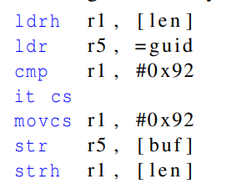
Analysis of “EMFI Attacks against USB Stacks “
Output of this request shows that register r1 is loaded first with the
wLength value passed from the host.
Only if the value of wLength is longer than the size of the
descriptor (0x92), then the wallet send that amount of packet otherwise the value in r1 overwritten to the size of the descriptor.
So somehow if we skip this checking part then as an attacker we can get return values as we wish.
To bypass this checking author has used EMFI(Electromagnetic Fault Injection).

Slide 27
Analysis of “Stealing Keys From Hardware Wallets“
Previous research paper require a finely controlled environment or a learning phase of target devices’ physical properties before the attacks.
The proposed attack needs a single power trace measured when wallets process elliptic curve scalar multiplication with private keys
The attack is reasonable since we do not damage the device under attack and do not target a specific device but an algorithm
Author mounted attack with three datasets: simulation, ChipWhisperer, and actual dataset collected from Trezor Model One

Slide 28
Analysis of “Stealing Keys From Hardware Wallets“
Hierarchical deterministic wallets : used to generate private key inside wallet
There are various Cryptographic algorithms in wallets like :
Elliptic Curve Scalar Multiplication
Conditional Negation
Point Addition
Field Multiplication Modulo p256
To recover the key, author extract the Conditional variable used in the Conditional Negation algorithm and also extract the point of addition
From these two variable they extract the private key.

Slide 29
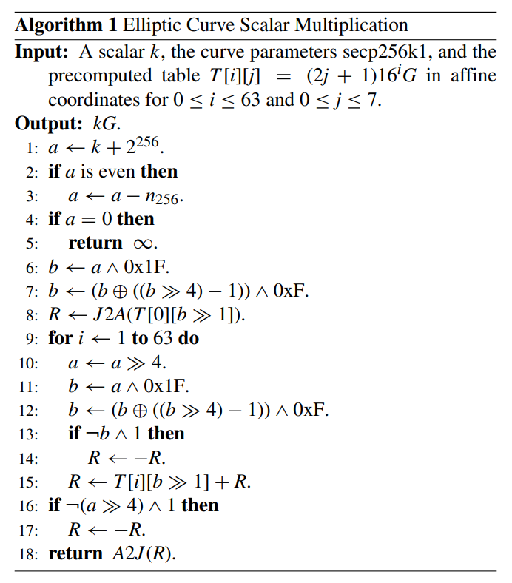

Analysis of “Stealing Keys From Hardware Wallets“
Steps 1-5 make a temporary scalar a = k + 2^256 neither even nor zero.
Steps 6-8 compute R = |a0|G in Jacobian Coordinates.
Steps 10-12 construct |ai| .
Steps 13-14 negate the previous result if sign(ai) != sign(a_i-1)
Step 15 performs affine-Jacobian mixed point addition using precomputed point T. so now result will be
Step 16-17 negate the last result with the same condition above.

Slide 30
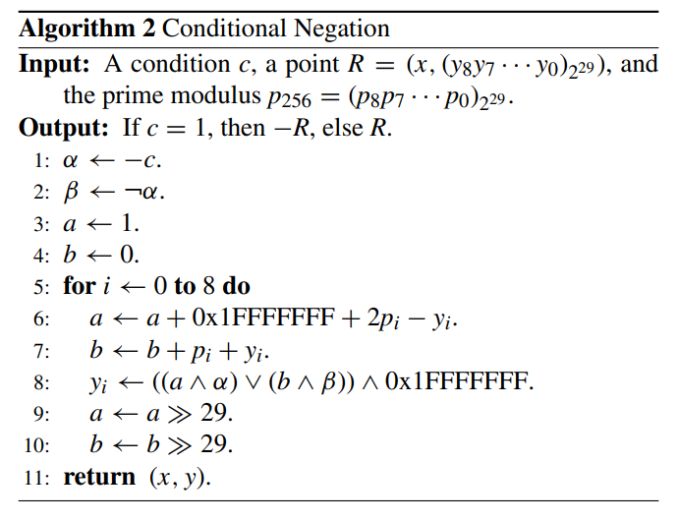
Analysis of “Stealing Keys From Hardware Wallets“
This algorithm takes an input R=(x,y) and return the additive inverse –R = (x,-y) only If the condition is c=1, otherwise output is same as input.
For making execution time constant, they use two 32 bits mask a(alpha) and b(beta), if the attacker know the value of the mask variable using a side channel attack then they can find condition variable c(1 bit information of the temporary scalar a).
Steps 5-10 calculate –y mod p256.

Slide 31
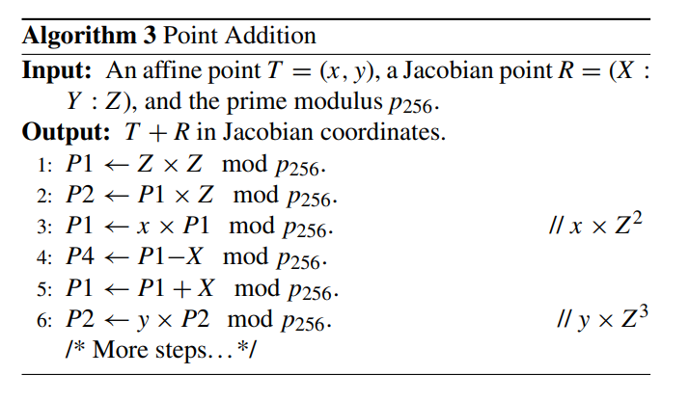
Analysis of “Stealing Keys From Hardware Wallets“
This algorithm requires an affine point T and a Jacobian point R, and it returns T+R in Jacobian Coordinates within 14 field multiplication modulo p256.
T is one of the precomputed points among the eight in the i-th row of the table.
If the attacker knows the exact point through side-channel attacks, it will leak 3-bit information of the temporary scalar a.

Slide 32
Analysis of “Stealing Keys From Hardware Wallets“
Now we try to extract conditional variable c from algorithm 2
The possible value of alpha and beta in algo 2 is 0xFFFFFFFF and 0x00000000 depending on the conditional variable c. So their hamming weight are 32 and 0, so the power pattern where c=1 and c=0 will be distinguishable.
Algo 5 shows a procedure for estimating condition c.
By visual inspection, one should cut single power traces in 64 subraces because we have a total of 64 operations.

Slide 33
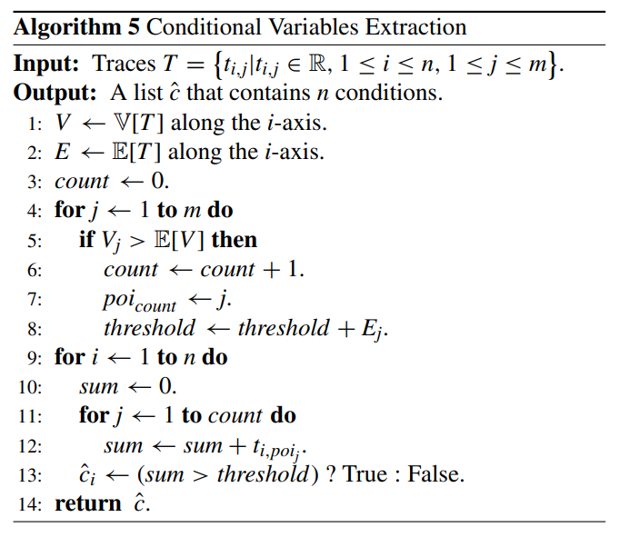
Analysis of “Stealing Keys From Hardware Wallets“
Steps 1 and 2 compute a variance trace V and and average trace E.
Step 3-8 identify point of interest(POI) that exceed the arithmetic mean of V over time.
POI indicates where variation in power according to the mask alpha is considerable and maximizes the distinguishability of each trace.
Count contains a number of POI
Threshold will be the sum of all the values at POI.
Steps 9-13 make a Boolean list of conditions whether subraces exceed the threshold or not.

Slide 34
Analysis of “Stealing Keys From Hardware Wallets“
So for every iteration output of C_i implies whether the i-th conditional operation of the ECSM negates the point R or not.

